Slide 1
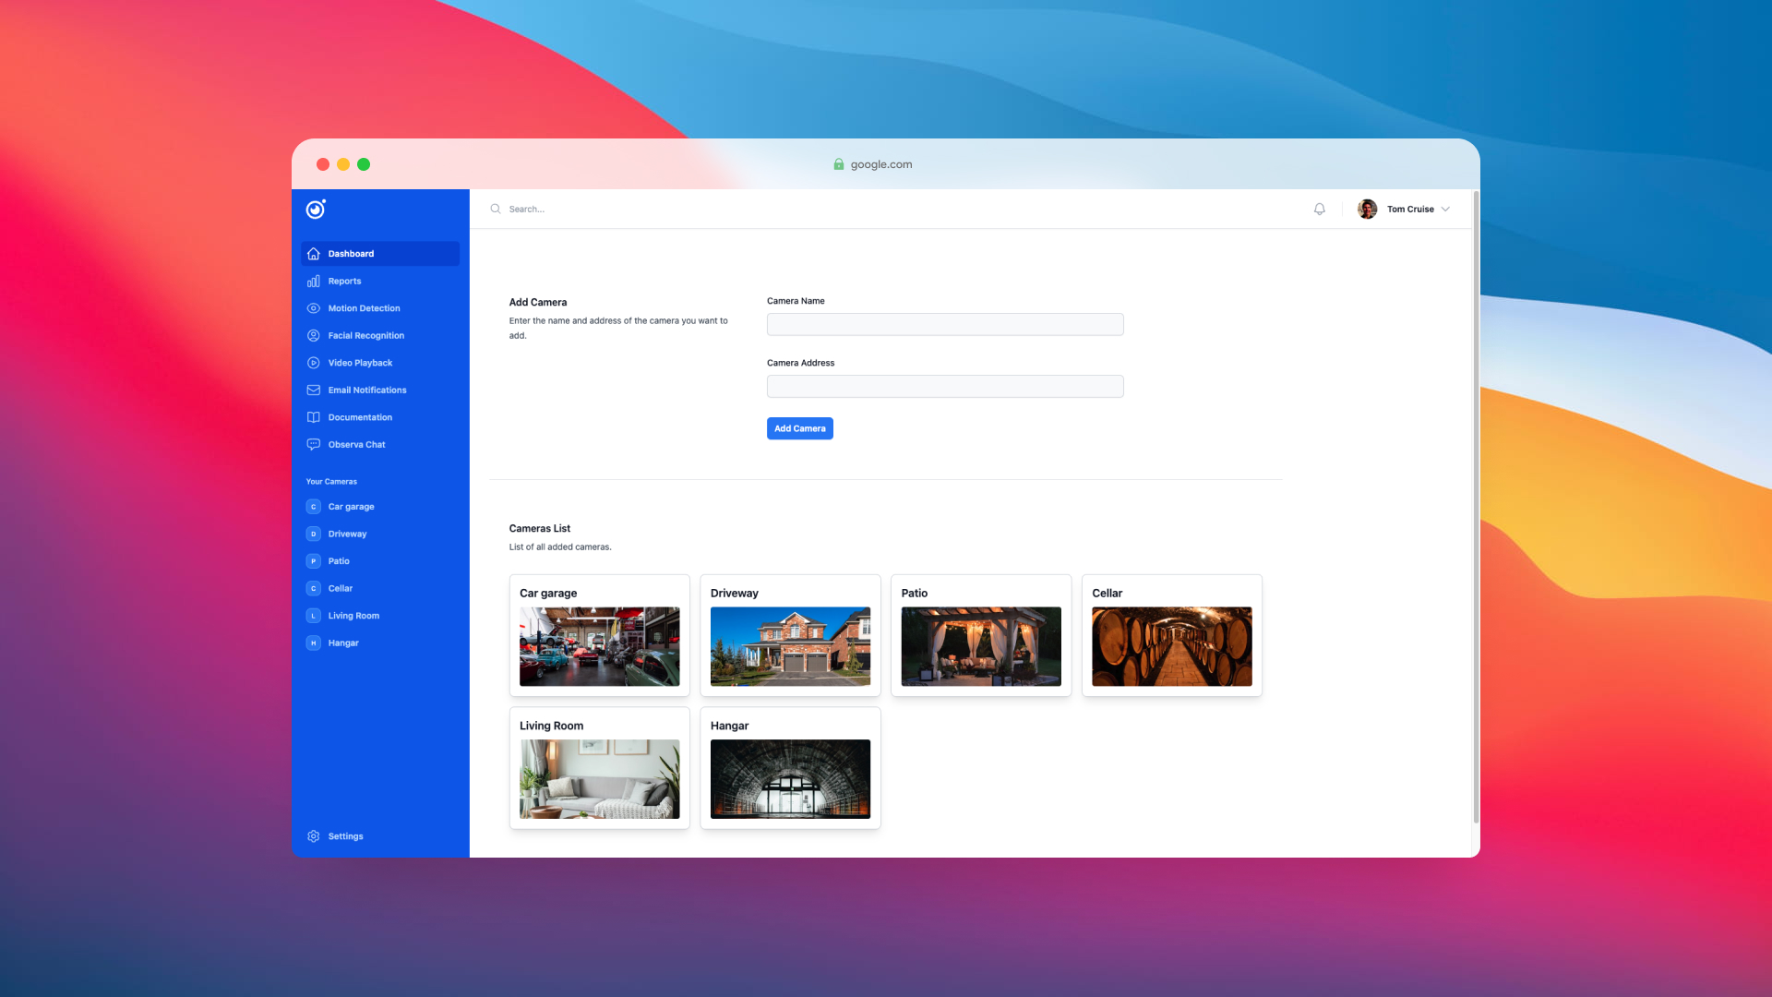
Observa - Video Surveillance System 📹
🎉
Miha Čakš, Gal Dvoršak, and Gregor Špan the minds behind Observa.
⭐
Observa

Slide 2
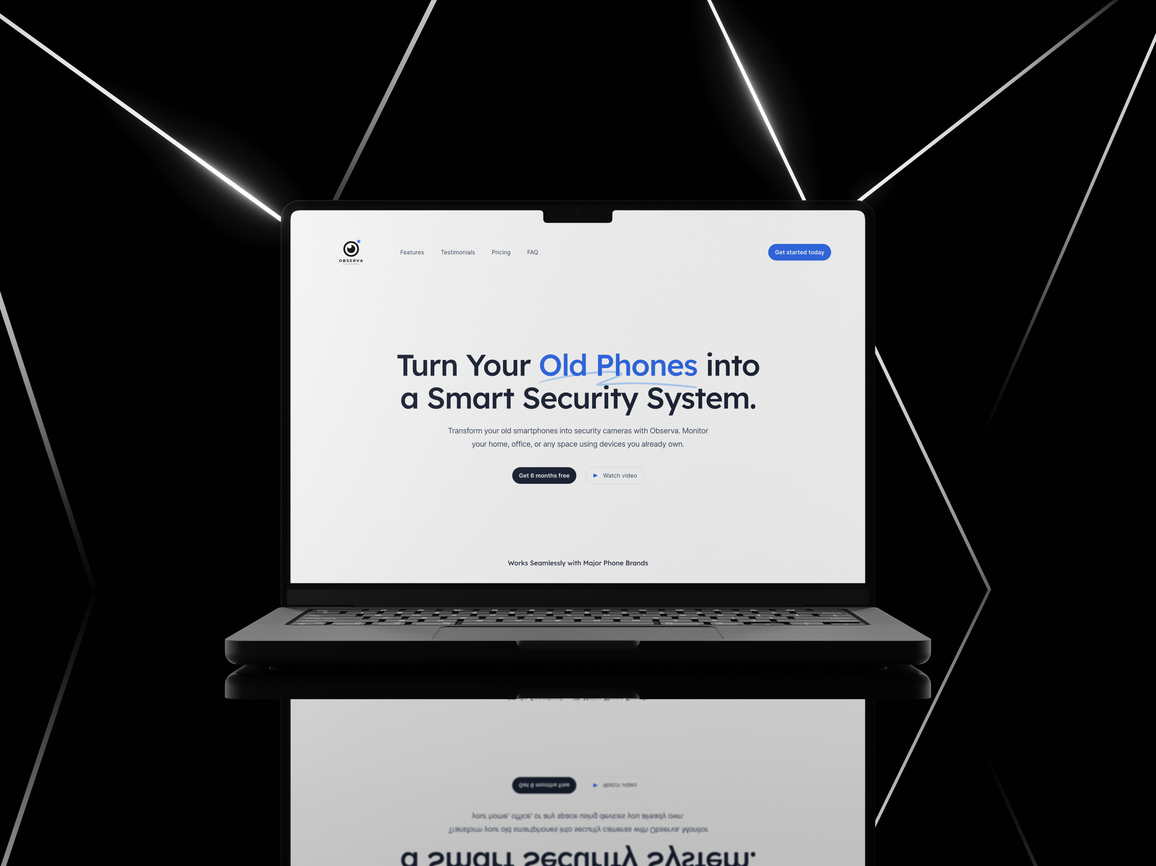
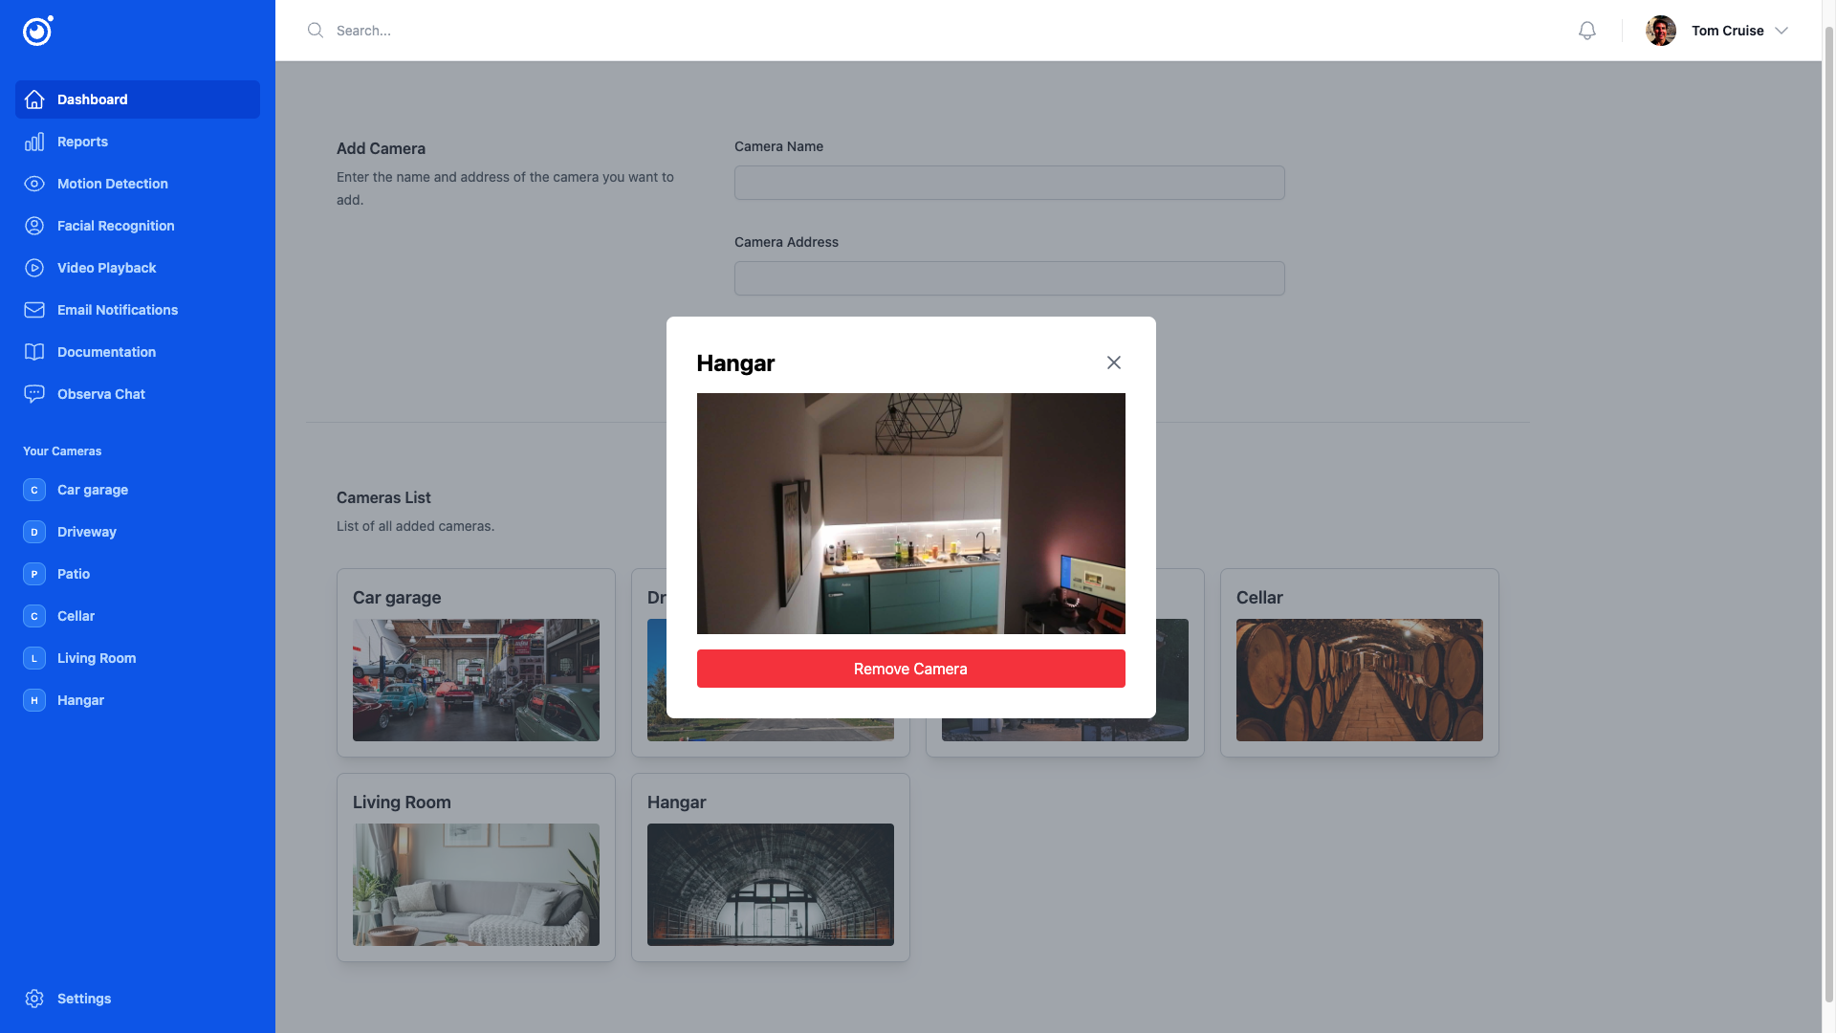
Observa
Agenda
01
Overview
02
Key features
03
Live demo
04
Q&A session

Slide 3
Observa 📹
⭐
Imagine transforming your old Android phones into a powerful video surveillance system.
Explore More
🎉

Slide 4
Observa
Secure your home, office, or any property effortlessly through our user-friendly web app.
🔒
✨
👀
🐼
User Friendly Interface
24/7 Winning Support.
Have everything under control
Security and peace of mind with no hassle.
Use old Android phones 📱 as a video surveillance system.

Slide 5



01
02
Remote Access
Live Observation
Highlight Features
03
05
06
Multi-Device Support
Motion Detection & Facial Recognition
Observa Chat
04
07
Notifications
Reports

Slide 6




React library using JavaScript 💻.
BE
FE
Backend
Frontend
Technology Stack
Python with Flask framework 🐍. NoSQL database MongoDB and Amazon S3 for video storage ☁️. API testing with Postman.

Slide 7

Observa
Demonstration
Video Camera Setup
Real-time video streaming for instant monitoring.
01

Slide 8
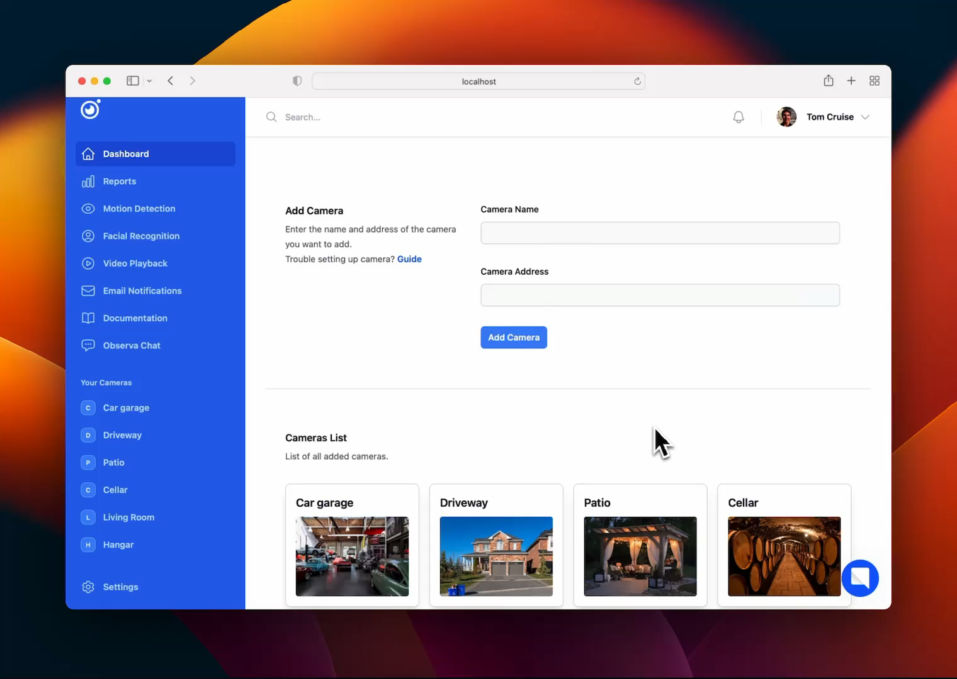
Motion & Facial Recognition
Capture and manage images seamlessly.

Slide 9

Observa
Demonstration
Observa Chat
AI security specialist for real-time support.
03

Slide 10
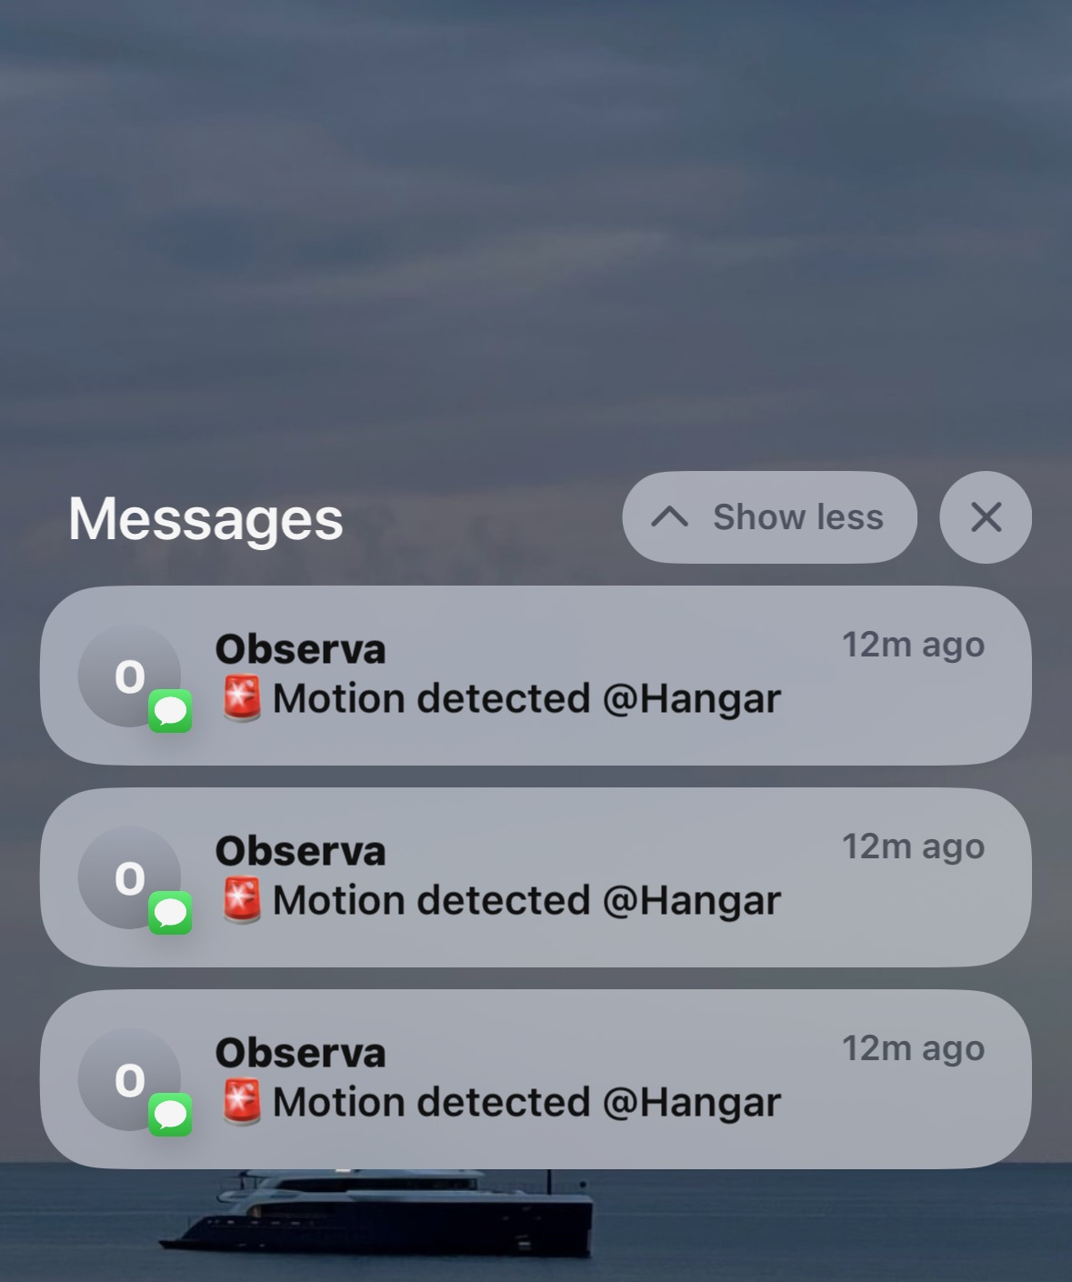
Notifications
Instant alerts via Email and SMS.
SMS alerts
Email notifications
Alert & Location
Alert, Location, Timestamp & Image

Slide 11
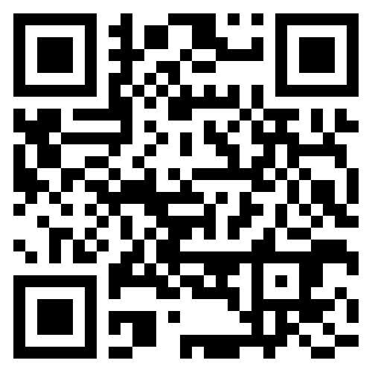
Observa
Accessing the App
Use the QR code to visit our landing page, where you’ll find all the information you need.
While exploring, you’ll have access to all functionalities except reports and video playback, as they require paid APIs.
tom.cruise@maverick.com
password1​
🔑

Slide 12
Observa
Q&A Session
Ask us anything about Observa and its features.
For additional questions, our AI chatbot on the landing page is ready to assist you.
tom.cruise@maverick.com
password1​
🔑

Slide 13
Observa - Video Surveillance System 📹
🎉
Miha Čakš, Gal Dvoršak, and Gregor Špan the minds behind Observa.
⭐
Observa

